Slide 1
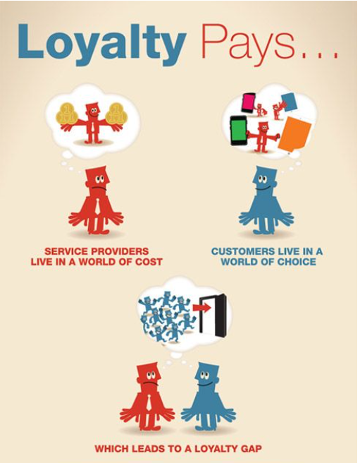
Sprint 1 report
By: Mitchell McCallum
Notes:
Hey guys this is my Sprint 1 update report and I intend to dive into the world of customer churn and I have a dataset from the telecoms industry so lets get into the details of my project!

Slide 2

Understanding Customer Churn in Telecoms
Introduction to the Telecom Industry
A competitive industry.
Customer retention is key!
Problem Statement
Customer churn costs money!
Opportunity
Data to predict and reduce churn.
Improve brand image.
Notes:
Introduction to the Telecom Industry
Competitive Landscape:
The telecom industry is fiercely competitive with numerous players striving for market share.
Advances in technology and the rise of digital communication platforms have intensified competition, making innovation and service quality key differentiators.
The ubiquity of mobile devices means telecom services are more essential than ever, leading to a battle over not just price, but also network coverage, customer service, and value-added services.
Customer Retention:
In such a competitive market, acquiring new customers is often costlier than retaining existing ones.
Customer loyalty and retention are crucial for sustainable growth. A strong customer base leads to a steady revenue stream and can become a source of positive word-of-mouth promotion.
Retained customers may also purchase more over time and are more likely to subscribe to additional services.
Problem Statement
Customer Churn:
Customer churn, which is when subscribers discontinue their services, is a significant challenge in the telecom industry.
High churn rates can be indicative of deeper issues within the company, such as poor service quality, inadequate customer support, or pricing problems.
Business Impact:
Churn impacts the bottom line through direct loss of revenue and the potential loss of future earnings from long-term customers.
It increases costs due to the need for additional marketing and promotion to replace the lost customers and can also lead to increased spending on market research to understand the causes of churn.
Opportunity
Data-Driven Churn Reduction:
With the wealth of data available, telecom companies can employ predictive analytics to identify at-risk customers before they leave.
Data mining techniques can uncover patterns and predictors of churn, allowing companies to take proactive measures.
Value of Customer Retention:
Retaining customers is more cost-effective than acquiring new ones and helps maintain a solid market position.
Loyal customers contribute to a positive brand image and can act as brand ambassadors.
By leveraging data to enhance customer satisfaction and reduce churn, companies can increase their competitive edge and secure their market position.

Slide 3
Data-Driven Approach to Reduce Churn
Role of Data Science
Identify trends based on operations produced data
Predictive Modeling
Machine learning allows computers to predict outcomes based on data it has already seen
Actionable Insights
Predictive modeling is a source of valuable information to inform company strategy.
Notes:
Role of Data Science in Churn Prediction
Data Science serves as the nexus between raw data and strategic decision-making. It employs a mix of statistical analysis, machine learning, and data visualization to unravel complex data sets, searching for patterns that are not immediately apparent.
Identifying Patterns and Predictors:
Data scientists analyze customer behavior, usage patterns, service utilization, and demographic data to uncover trends associated with churn.
For instance, a high frequency of customer service calls might correlate with increased churn, indicating customer dissatisfaction.
Real-World Example:
A telecom company might use clustering techniques to segment customers into groups based on usage patterns. Upon analysis, they may find that a segment with high data usage but low engagement with customer service is prone to churn. Targeted offers for improved data plans or loyalty rewards can then be crafted for this segment.
Predictive Modeling
Predictive modeling is a forward-looking data science technique that leverages historical data to predict future outcomes. In churn prediction, models are trained to forecast the likelihood of a customer ending their service.
Machine Learning for Churn Prediction:
Algorithms such as logistic regression, decision trees, or neural networks are trained on historical data to recognize the signs of impending churn.
Features like length of service, plan changes, and billing history are fed into the model, which learns the churn patterns.
Actionable Insights for Retention Strategies
The culmination of predictive modeling is the generation of actionable insights that can directly inform business strategy, particularly in crafting targeted retention interventions.
Informing Targeted Retention Strategies:
By knowing which customers are at risk, companies can proactively engage with them through special offers, personalized communication, and improved service options.
This targeted approach ensures resources are allocated efficiently, focusing retention efforts where they are most needed.
Real-World Example:
A telecoms provider might identify that customers who experience service disruptions are likely to churn. Before the customer cancels, they might reach out with a service upgrade offer or a discount to mitigate dissatisfaction.
The Role of Machine Learning in Customer Retention Strategies
Machine learning (ML) is a cornerstone of modern customer retention strategies. It provides the automation and scale required to analyze vast datasets and enables personalized customer experiences.
Personalization at Scale:
ML algorithms can process complex customer data to personalize the retention strategies at an individual level.
For example, predictive models can suggest the next best action for customer service representatives to take during a call, tailored to each customer's situation.
Continuous Learning:
These models continually learn and improve over time as more data becomes available, leading to increasingly accurate predictions.
A/B testing different retention strategies can also be used to feed information back into the models, refining their predictions.

Slide 4

Impact of Predicting and Reducing Churn
Business Impact
Churn rates to drop to a range between 21.54%-16.54% a
decrease of 10%-5%.
Savings in marketing and acquisition.
Customer Satisfaction
Personalized retention strategies can lead to improved customer experience and loyalty
Notes:
Estimate Business Impact
Assuming that effective churn reduction strategies can lower the churn rate by, for instance, 5 to 10 percentage points (which is a significant but realistic target), we could expect the churn rate to drop to a range of about 16.54% to 21.54%. The impact of this reduction can be substantial:
Reduction in Churn Rates: A decrease in churn rates directly translates to a higher number of retained customers.
Increase in Customer Lifetime Value (CLTV): Retaining customers for a longer period increases their lifetime value. For instance, even a modest increase in retention can lead to a significant increase in CLTV.
Savings in Marketing and Customer Acquisition Costs: Acquiring a new customer can be several times more expensive than retaining an existing one. Thus, reducing churn can lead to considerable savings.
Customer Satisfaction Improvements
Implementing personalized retention strategies such as tailored offers, responsive customer service, and engaging communication can significantly improve customer satisfaction and loyalty. Satisfied customers are less likely to churn and more likely to become advocates for the company, potentially attracting new customers through word-of-mouth.

Slide 5
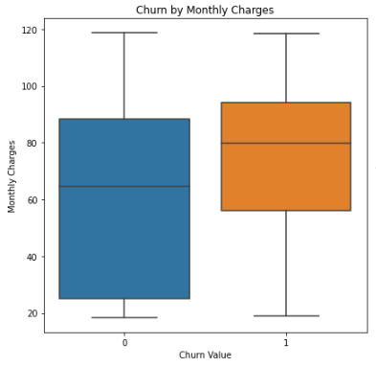
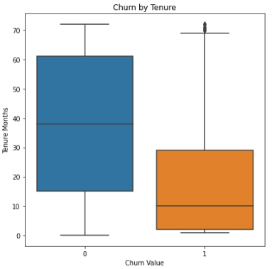
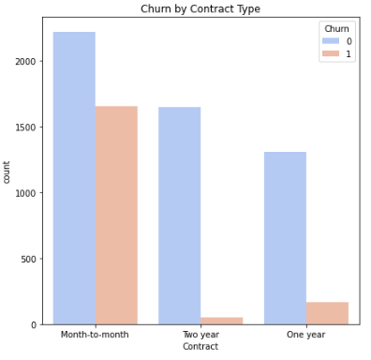
Dataset Overview and Initial Insights
Higher clustering of charges
For those who do churn
Churn clustered around newer customer
Churn rates decline
dramatically for
contracts
Notes:
Preliminary EDA Findings
The visualizations provide the following insights:
Churn by Tenure: Customers with lower tenure are more likely to churn than those with higher tenure. The boxplot shows that the median tenure for customers who have not churned is higher than that for those who have churned.
Churn by Monthly Charges: There's a wider spread in the monthly charges for customers who have churned, indicating higher monthly charges are associated with churn. The median monthly charge for churned customers is also higher compared to non-churned customers.
Churn by Contract Type: Customers with month-to-month contracts are more likely to churn than those with one or two-year contracts. The countplot indicates a higher churn count for month-to-month customers compared to one-year and two-year contracts.
These findings suggest that short-term customers or those facing higher monthly charges are at higher risk of churning. Conversely, customers with longer tenure and those on long-term contracts tend to stay with the company.
These insights can be crucial for developing targeted strategies to reduce churn, such as:
Offering incentives for longer contract commitments.
Reviewing pricing strategies to ensure competitiveness and fairness.
Providing loyalty benefits to long-tenured customers.

Slide 6

Roadmap for Advanced Analysis
Data Preparation:
Feature Engineering:
Baseline Modeling:
Iterative Improvement:
Notes:
Data Preparation:
Further Data Cleaning:
Handling Missing Values: Depending on the context, handle missing values by imputation, removal, or by using algorithms that support missing values.
Outlier Detection: Identify and handle outliers as they can skew the results. Techniques such as Z-scores, Interquartile Range, or visual methods to determine what should be removed.
Normalization:
Scale numerical features to a standard range using techniques like Min-Max scaling or Z-score standardization. This ensures that all features contribute equally to the result.
Encoding Categorical Variables:
Convert categorical variables into a format that can be provided to ML algorithms. This involves using techniques like one-hot encoding, label encoding, or embedding layers for deep learning models.
Feature Engineering:
Creating New Features:
Interaction Terms: Create new features that are combinations of existing features for instance an interaction feature between 'Tenure Months' and 'Monthly Charges' might capture customers with high tenure and high charges who might have a different churn risk.
Aggregation: For time-series data or if multiple rows per customer exist, aggregate data to create customer-level features.
Temporal Features: If timestamps are available, create features like "days since last purchase" or "activity in the last X days".
Customer Segmentation: Use clustering to group customers and use the cluster memberships as new features.
Baseline Modeling:
Given the dataset:
Approach for Building and Evaluating Models:
Model Selection: Start with a simple logistic regression to establish a baseline. Then, consider more complex models such as random forests and gradient boosting machines (like XGBoost).
Cross-Validation: Employ stratified K-fold cross-validation to maintain the same proportion of churned customers in each fold as the full dataset.
Performance Metrics: Use AUC-ROC as the primary metric due to the imbalanced nature of churn datasets, complemented by precision, recall, and F1-score.
Iterative Improvement:
Model Refinement:
Hyperparameter Tuning: For complex models, use techniques like Random Search or Bayesian Optimization to find the best parameters.
Feature Selection: Apply methods such as model-based feature importance or SHAP values to identify and keep the most predictive features.
Validation for Accuracy and Reliability:
Validation Sets: Use a separate validation set to test the model's performance. This helps in simulating how the model would perform on unseen data.
Model Interpretability: Since business stakeholders might require explanations, use interpretable models or model-agnostic interpretation techniques to explain predictions.
Model Monitoring: Develop a system for monitoring model performance over time to detect concept drift and schedule retraining when necessary.

